Slide 1
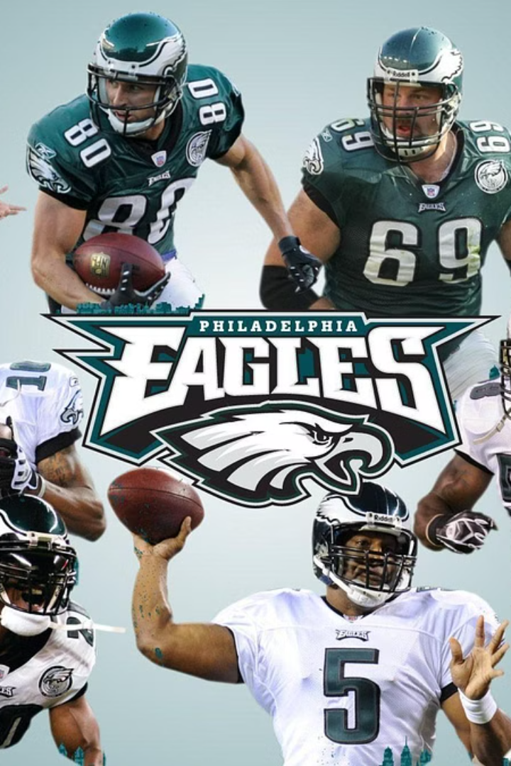


The Philadelphia Eagles: An Overview
The Philadelphia Eagles are a professional American football team based in Philadelphia, Pennsylvania. They have a storied history in the NFL, known for their passionate fan base, fierce rivalries, and championship-caliber teams over the decades.
by Max Orenstein

Slide 2

The Eagles' Storied History
1
Established in 1933
The Eagles were founded in 1933 and joined the National Football League, quickly establishing themselves as a competitive franchise.
2
First Championship in 1948
The Eagles won their first NFL championship in 1948, sparking a legacy of success and loyalty among their devoted fanbase.
3
Super Bowl LII Victory
In 2017, the Eagles won their first Super Bowl championship, defeating the New England Patriots in a thrilling game that cemented their place in NFL history.

Slide 3
Key Players and Standout Performances
Legendary Quarterbacks
Defensive Stalwarts
Iconic Performances
The Eagles' defense has been anchored by dominant players like Reggie White, Brian Dawkins, and Fletcher Cox, who have earned multiple Pro Bowl selections and helped the team win championships.
Memorable moments in Eagles history include Randall Cunningham's acrobatic touchdown runs, Malcolm Jenkins' game-changing interceptions, and Nick Foles' MVP performance in Super Bowl LII.
The Eagles have been led by many exceptional quarterbacks, including Norm Van Brocklin, Donovan McNabb, and Carson Wentz, who have all made significant contributions to the team's success.

Slide 4
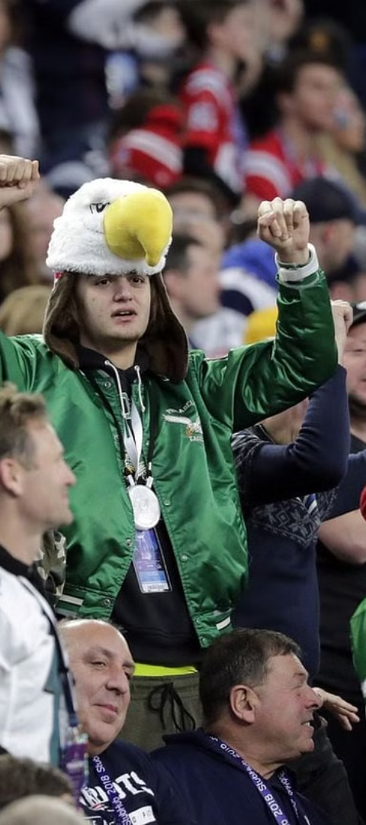



The Eagles' Road to Success
Consistent Playoff Appearances
The Eagles have been a regular fixture in the NFL playoffs, with 26 postseason appearances and 3 Super Bowl appearances in their storied history.
Dedicated Coaching Staff
The Eagles have been led by innovative and successful coaches, such as Andy Reid and Doug Pederson, who have helped the team maintain a high level of competitiveness.
Passionate Fan Base
The Eagles' loyal and enthusiastic fanbase, known as the "Midnight Green Army," have been a driving force behind the team's success, providing unwavering support through thick and thin.

